Slide 1
Neural Networks Assignment

Slide 2
Sections in the code
Preparation of Data
Network Architecture
Learning rate
Dropout rate

Slide 3
Preparation of Data
Import CIFAR10 (60,000 32x32 pixel colour images)
Split into training and test data
Array of integers (32x32x3 per image)
Each image has a corresponding label
Experiment 1:
2/3 images for training, 1/3 images for testing
Experiment 2:
½ images for training, ½ images for testing

Slide 4
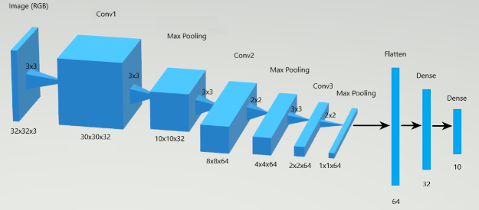
Network Architecture
Brief
Testing
Outcome
3 Convolutional layers
2 Fully connected layers
Max Pooling layers
Flattening layer
Activation functions
ReLU (0+)
Softmax (0 – 1)
Optimisation functions
Adam
SGD
3 Convolutional layers
A Max Pooling layer after each
A Flattening layer
2 Fully Connected layers
Adam
ReLU

Slide 5
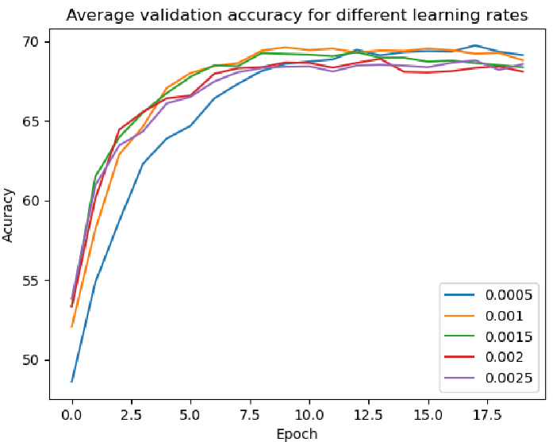
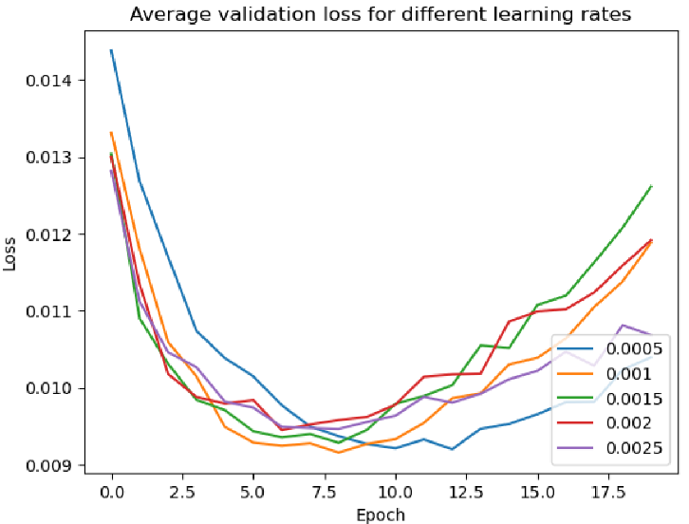
Experiment 1 – Learning Rate
Brief
Testing
Outcome
Compare networks with a set learning rate to ones using a Scheduler
Learning Rates
0.0005, 0.001, 0.0015, 0.002, 0.0025
Compared Results
Scheduler
Various learning rate combinations
0.0005 had highest accuracy and least overfitting
took longer
Scheduler was
More consistent between trials
Higher loss over 20 epochs

Slide 6
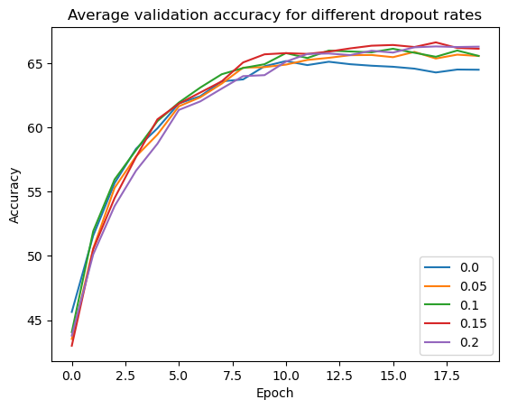
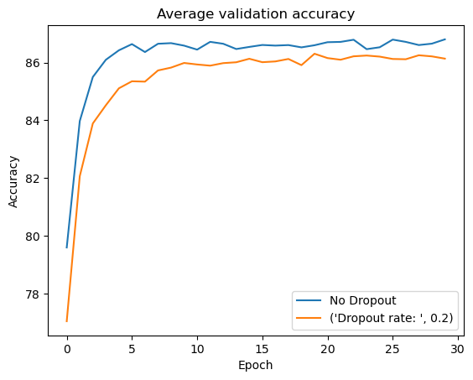
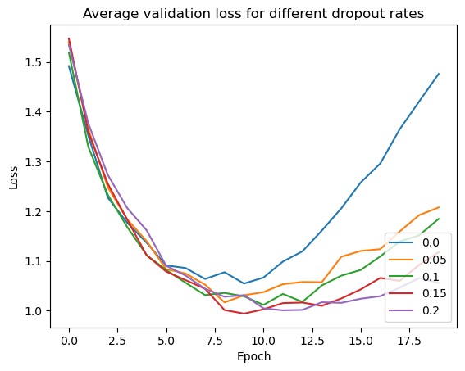
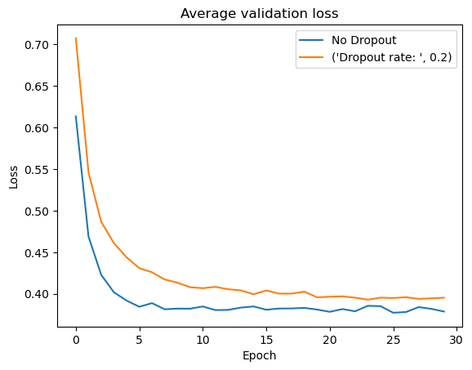
Experiment 2 – Dropout Rate
Brief
Testing
Outcome
Investigate how dropout can affect a neural network
Dropout Rates
0, 0.05, 0.1, 0.15, 0.2
Compared Results
Freezing layers
0.2 dropout had highest accuracy and lowest loss
0 dropout was led to a more accurate network

